Slide 2
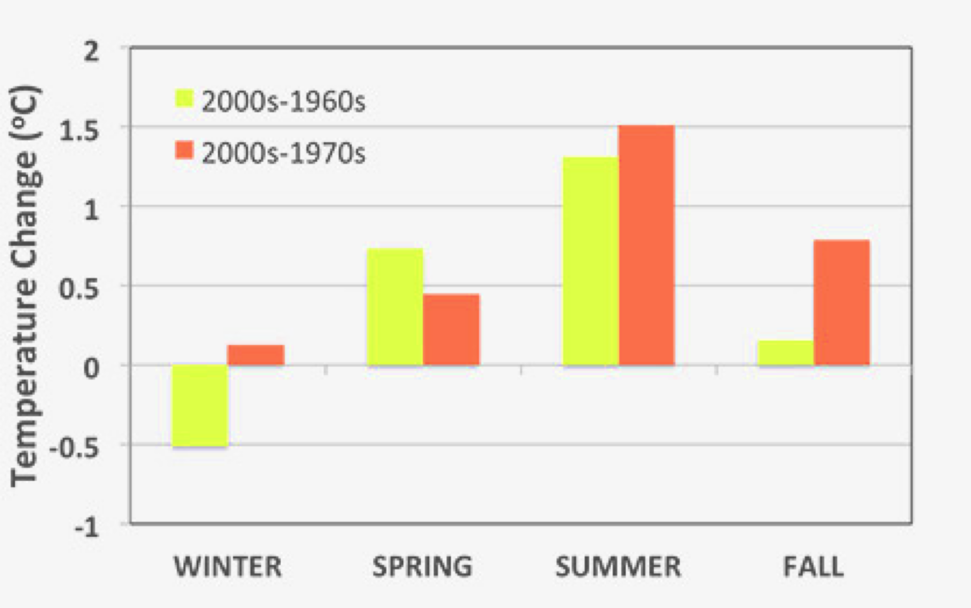

Slide 3
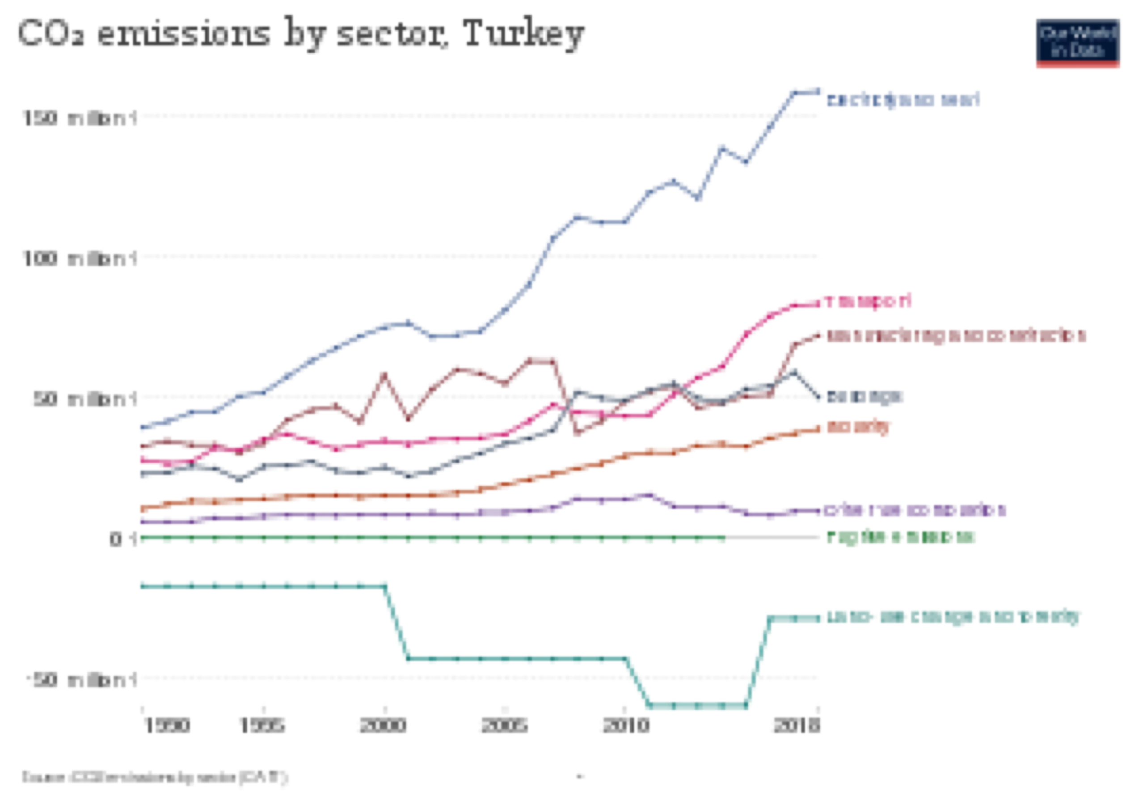

Slide 4
Solutions
Legal regulation on allocation of water resources and protection against pollution( Environment and Urban Ministry-Climate Change Adaptation Strategy and Action Plan,
Protection of surface and underground water resources from pollution
Effective use of the country's water resources by reducing losses in existing water supply facilities

Slide 5
Student Affiliation
Name-Student Number:Kemal Berke Yılmaz(802220714),Muhammet Serhat Başkan(820210311)
Faculty-Department:KKTC-Computer Engineering
Email :yilmazkemalberke@gmail.com,m.baskan1603@gmail.com
ING 100(15106)

Slide 6
References
https://www.wwf.org.tr/ne_yapiyoruz/iklim_degisikligi_ve_enerji/iklim_degisikligi/kuresel_iklim_degisikligi_ve_turkiye/
https://sdgs.un.org/goals/goal13
https://webdosya.csb.gov.tr/db/destek/editordosya/Iklim_Degisikligi_Uyum_Stratejisi_ve_Eylem_Plani.pdf

